Slide 1
Big data programming Project Plan
Class ids
3
15
9
2
Bhavaz AKULA(17282638)
Ahamed raziuddin(16275183)
Dinesh kusam
Alex acsenvil

Slide 2
Big-Data Benchmarks

Slide 3
Project plan
We want to check the run time of queries like ’like’ , ‘groupby’ ,’orderby’ , ‘count’ , ‘pattern-match’ , etc and help the users tell which one is best for which query and save their time from selecting which tool to be used.
I’m using the flight data set called ‘data expo 09’
I’m setting up hive, spark environment in ITversity labs ( CREDENTIALS :
Username : apandit7
Password : Ik0i0a6ti4aenguezei2Chie3Eupie0d ) It has around 400 GB of ram and it just costed me around 29$.
I have runned the like query in Hive , Hive with Tez, SparkDataFrame , SparkSQL.

Slide 4
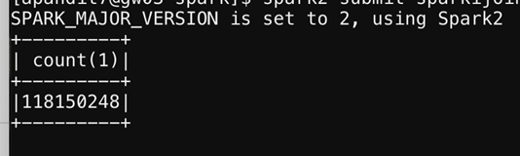
Data analyzed:
We have used the data set "Data expo 09" which consist of flight data from year 1987 to year 2019 having the details of year, month, airtime, etc.
We have worked on the data set which consists of 120 millions of records.
Data engineering has been on this data and anomalies have been removed and the final data we used for Data analysis is around 34GB.

Slide 5
Why big data BENCHMARKS?
Often we are overwhelmed with number of tools available for a purpose.
Particularly, Big data ecosystem is exploding along with the data.
Companies often tend to have most of them if not all and end up using very few.
Big data benchmarks help user to find which tool has to be used for required purpose.
It concentrates on evaluating querying tools hive, impala, sparkSQL, Hbase.

Slide 6
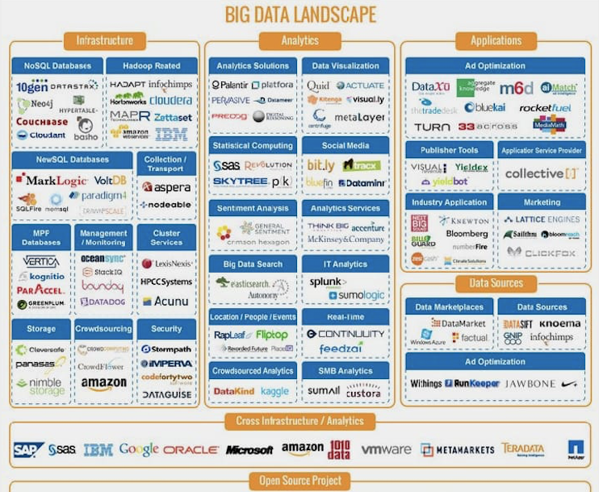

Slide 7
Motivation.
Buried under such a large landscape we want to find ways to breathe easy.
Have handful of tools useful for the purpose.
We want to come up with a solution. ‘Right tool at right time’.
To start with we have chosen querying tools that are popular.

Slide 8
Our PATH Towards our GOAL.
We would use cloud services to set up Hadoop cluster and running environment for all the tools.
Choose three categories of data based on size.
Choose multiple objectives as a user and perform tasks using all the tools we mentioned.
Come up with numbers and factors the helps user to choose tool that suits his purpose.
This saves user’s time of setting up irrelevant tools. Remind you setting up these tools is a lot involved process at scale which firms use.

Slide 9
Intended outcome.
No more confusion on picking right tool for the purpose.
Give us the size of data and most frequent operations that would be performed we would find right tool for you.

Slide 10
References.
www.hexanika.com.
www.pintrest.com.

Slide 11
Thank you!

